Slide 1

Comprehensive Digital Marketing
Project work
This Photo by Unknown Author is licensed under CC BY-SA-NC

Slide 2
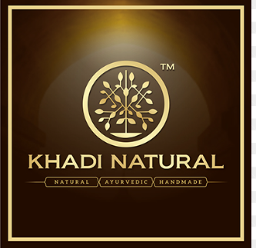
Khadi Naturals

Slide 3
Part 1: Brand study, Competitor Analysis & Buyer’s/Audience’s Persona
COMPANY/TOPIC for project : KHADI NATURAL
. Research Brand Identity:This study is the first to report in developing new insights on Khadi’s Brand Identity.
Brand Colors: Dark Brown, Black or Pure Indigo.
Logo:

Slide 4
Mission/values: Our commitment to our customers & consumers is to always provide them with the highest degree of pure, standardized & quality-oriented products.
USP: Khadi, Common perceptions say, the proud legacy of Mahatma Gandhi and potent tool of national freedom, is “ethical as well as ethnic “and its USP is natural, hand crafted, eco-friendly, bio-degradable and non-exploitive fiber.
Tagline: Khadi products bring harmony to your body, mind and soul.

Slide 5
Part 1: Brand study, Competitor Analysis & Buyer’s/Audience’s Persona
Competitor Analysis: Select three competitors operating in the same industry or niche as the chosen brand, examine their USPs and online communication.
Competitor 1: MAMAEARTH [
USP : Their unique selling point is the absence of toxins and harmful chemicals in their products. This has helped them in building a loyal customer base.
Communication : Social media websites are a key component of Mama earth's marketing plan. The company is present and active on numerous social media networks, including Facebook, Twitter, and Instagram.

Slide 6
Competitor 2: PLUM
USP : Having a light-hearted and sincere take on skin care.
Communication :We are using video and images first as an approach to communication.
Competitors 3 : mcaffeine
USP : mCaffeine’s USP is that they use Coffee in their ranges. Coffee is considered a superfood and it is known to be a great ingredient for skincare.
Communication : Genderless wellness seems to be stitched into the fabric of the brand ethos at mCaffeine, we look into how they portray it on social media.

Slide 7
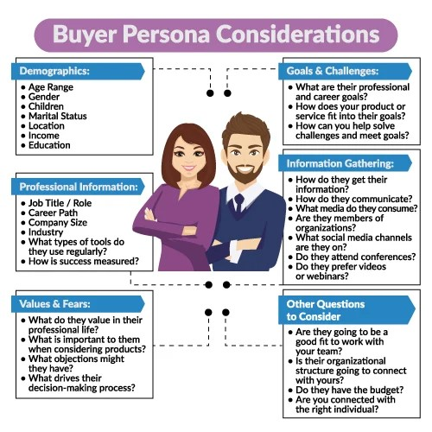
Part 1: Brand study, Competitor Analysis & Buyer’s/Audience’s Persona
Buyer's/Audience's Persona: Clearly define the target audience for the chosen brand. Consider demographics, psychographics, behaviors, and interests.
Khadi Natural Healthcare is a leading manufacturer, exporter and supplier for natural and authentic products covering 18 States and 35 authorized distributors all over India. Khadi Natural exports all around the world in 25 countries with above 50 authorized seller and distributors.

Slide 8
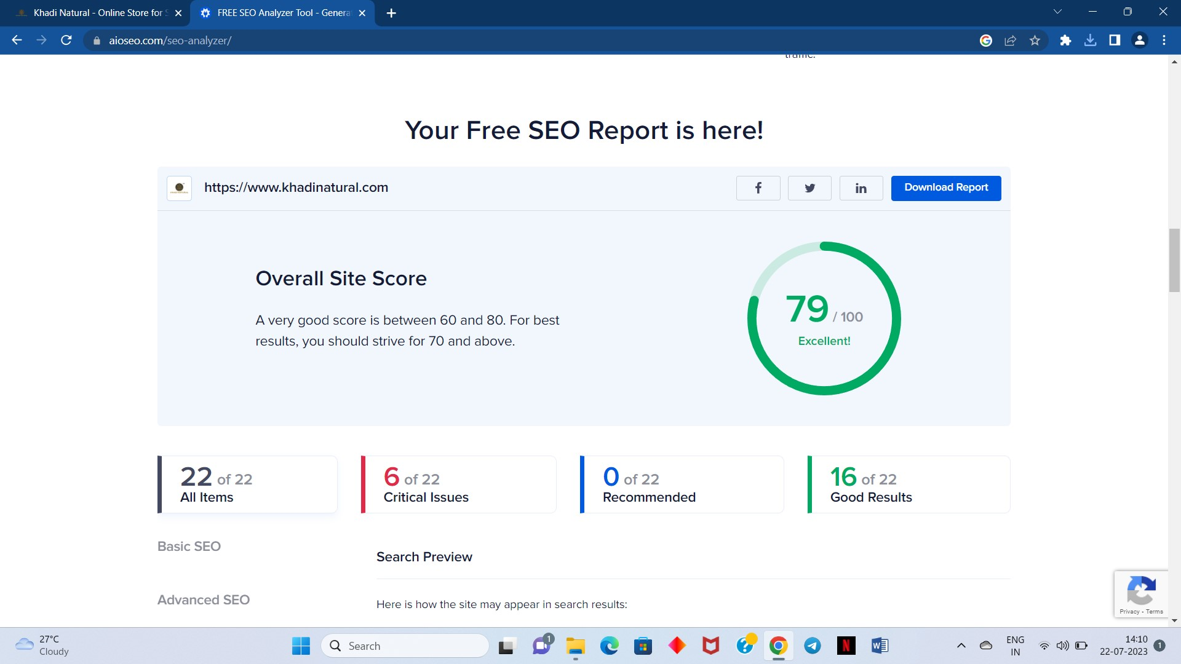
Part 2: SEO & Keyword Research
SEO Audit of Khadi Naturals :

Slide 9
Part 2: SEO & Keyword Research
SEO Title : Khadi Naturals -The Miracle of Natural Products.
Keyword Research:
Khadi Naturals research objectives : Our main objective is to help every individuals with herbal remedial solutions for all their healthcare related problems so that they can enrich a healthy life and for that we provide a wide range of high-quality products which are accumulated from purely herbal ingredients, derived from nature and cultures.
Keywords : Anti - Ageing Moisturiser.
●Delays signs of ageing and keeps skin healthy.
●Intensive moisturiser to replenish skin's natural moisture.
●Makes skin radiant by hydrating, moisturising and improving skin tone.

Slide 10
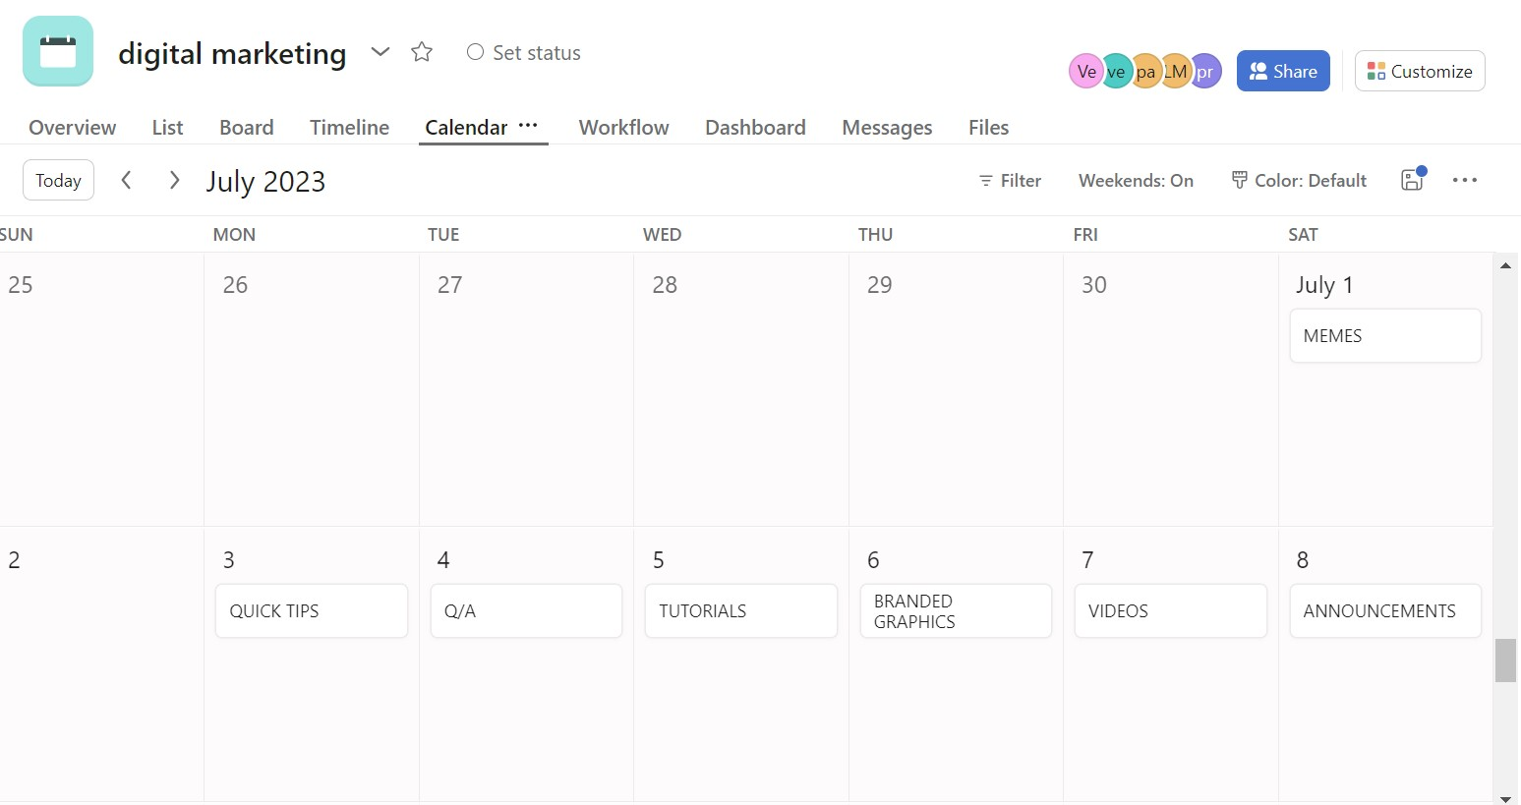
Part 3: Content Ideas and Marketing Strategies content calendar

Slide 11
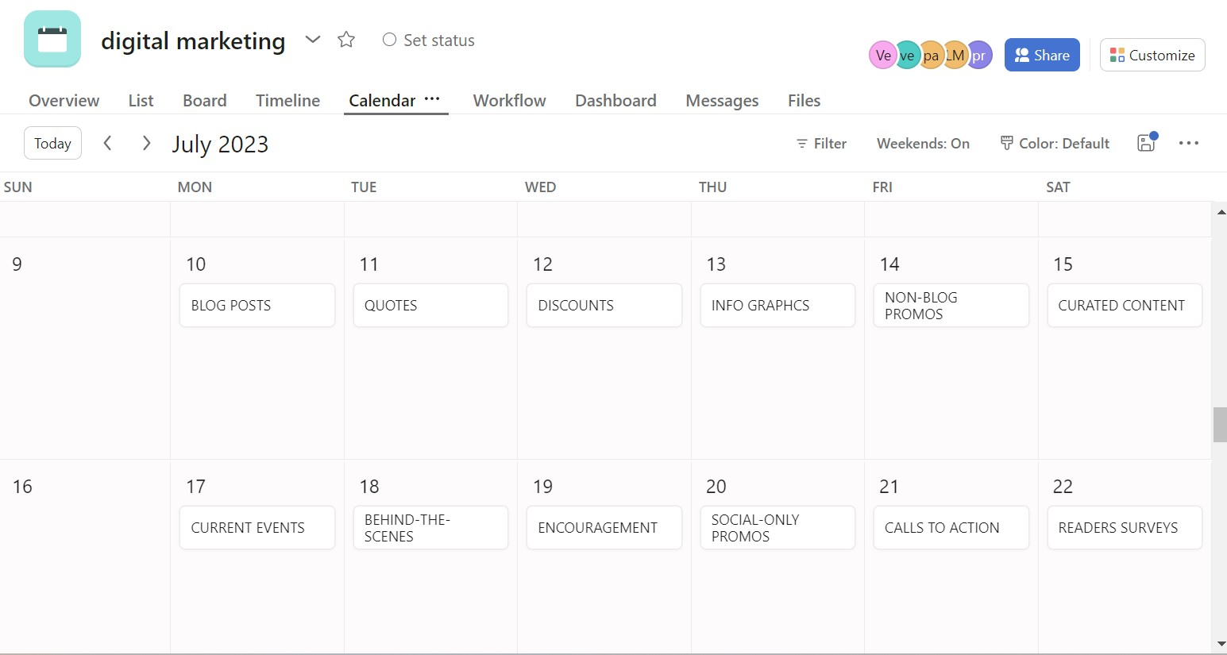
content calendar

Slide 12
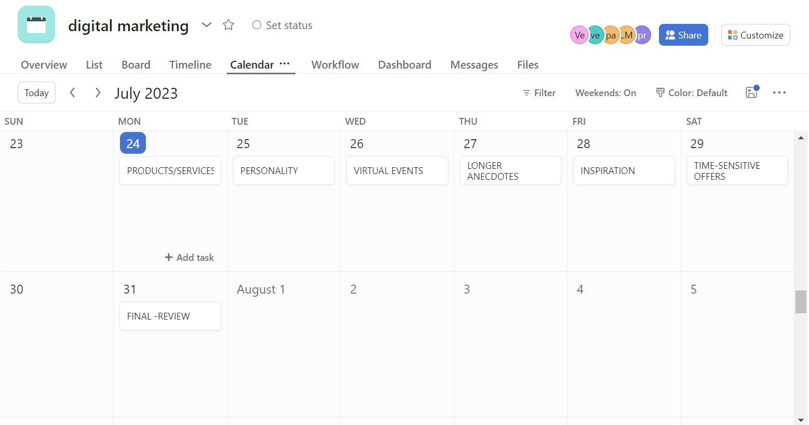
content calendar

Slide 13
Part 3: Content Ideas and Marketing Strategies
MARKETING STRATEGIES -Marketing strategy includes all basic, short-term, and longterm activities in the field of marketing that deal with the analysis of the strategic initial situation of a company and the formulation, evaluation and selection of market-oriented strategies and therefore contribute to the goals of the company and its marketing objectives. The Marketing initiatives taken by Khadi to increase sales are as below:
Product Development: As the World is moving towards a more sustainable and eco-friendly environment it has become imperative to promote more of Khadi Products as they are all natural and hand made products. The products offered by KVIC range from Khadi, fiber leather, cane bamboo, agarbatti , processed food products, honey and handmade paper. The sale is looking up in the last few years cause of the change in ideology.

Slide 14
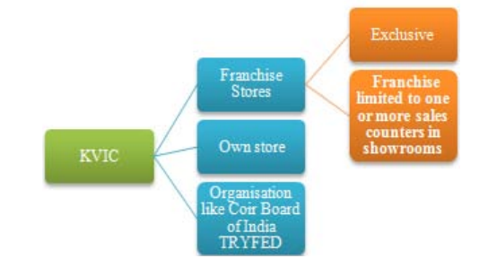
Increase in number of Sale Outlets: The franchise stores can be partly owned by KVIC at times and some are completely independent. One of the new options which has recently been introduced is to have small counters in a shop which has Khadi products. A pictorial representation in given below

Slide 15
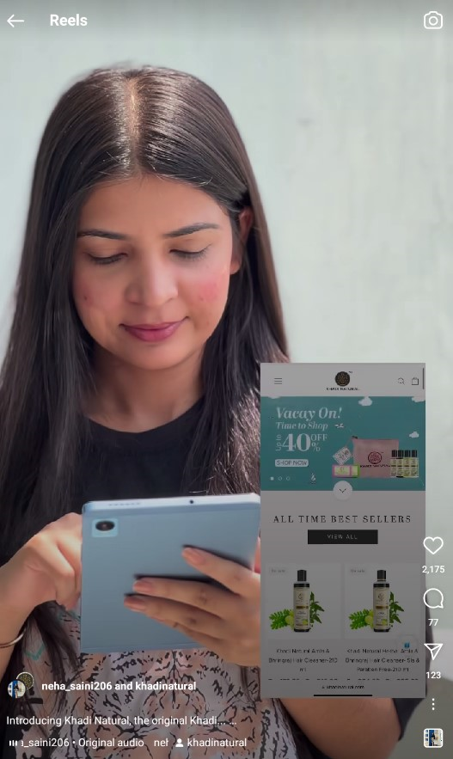
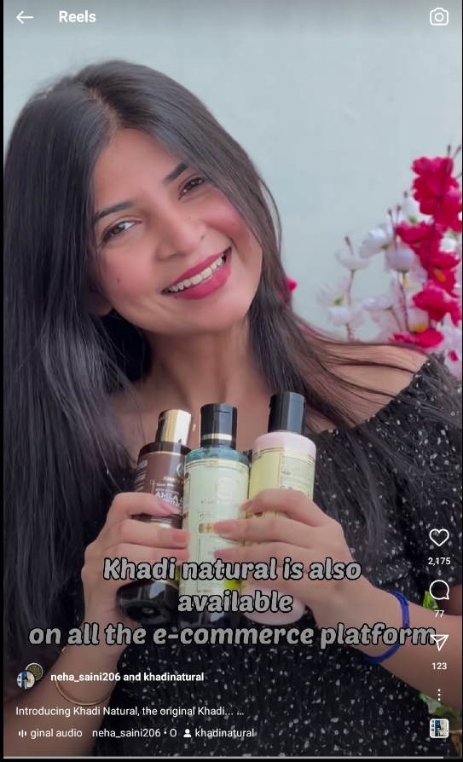
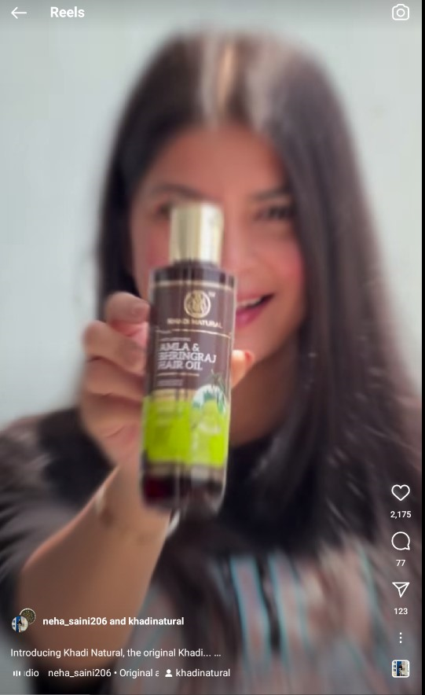
Part 4: Content Creation and Curation
POST CREATION
https://www.instagram.com/reel/CtD19fsADmN/?igshid=MzRlODBiNWFlZA==

Slide 16
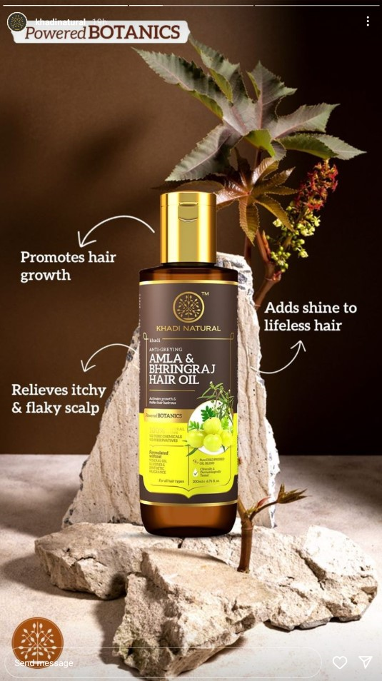
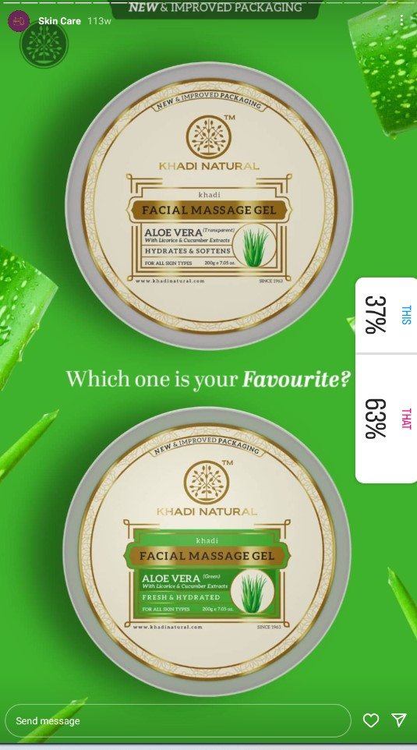
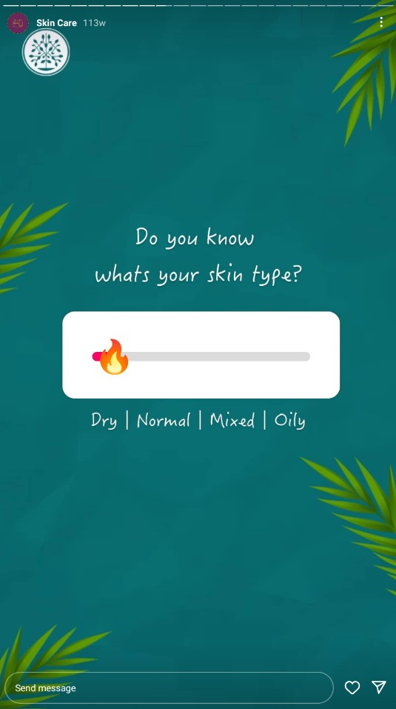
Part 4: Content Creation and Curation
Instagram Story

Slide 17
Part 4: Content Creation and Curation
Designs/Video Editing
Content Creation:
Brands are in the constant pursuit of creating engaging content that their viewers would resonate with. However, creating such content calls hours of planning effort, and you need to arrange the resources for the filming and editing.
As a result, many brands give up on the idea of content creation altogether. Others settle on creating video content after long intervals. Choosing either of these two paths will cause your audience to forget your brand or seek alternative service providers. Video curation is the best way for brands to strike a balance and give viewers what they want without going through the strenuous process of content creation.
Video Curation :
Video curation is the process of identifying relevant videos on a given subject and collecting them together. You then identify the ones that are the most appropriate and then compile them together. Depending on the nature of the video, you may want to edit them before sharing them with your circle.
The major challenge of video curation is devoting long hours to identifying relevant videos and then selecting the very best ones. However, this is simpler than creating original content every day and is an effective way of establishing brand familiarity with your target group.

Slide 18
Part 4: Content Creation and Curation
Designs/Video Editing

Slide 19
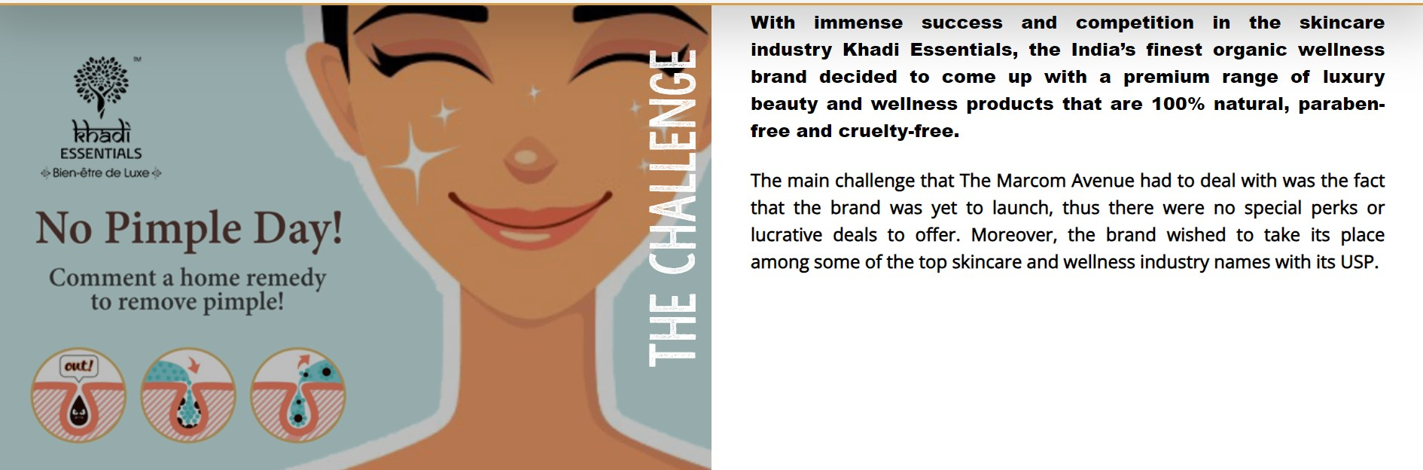
Part 4: Content Creation and Curation
Social Media Ad Campaigns

Slide 20
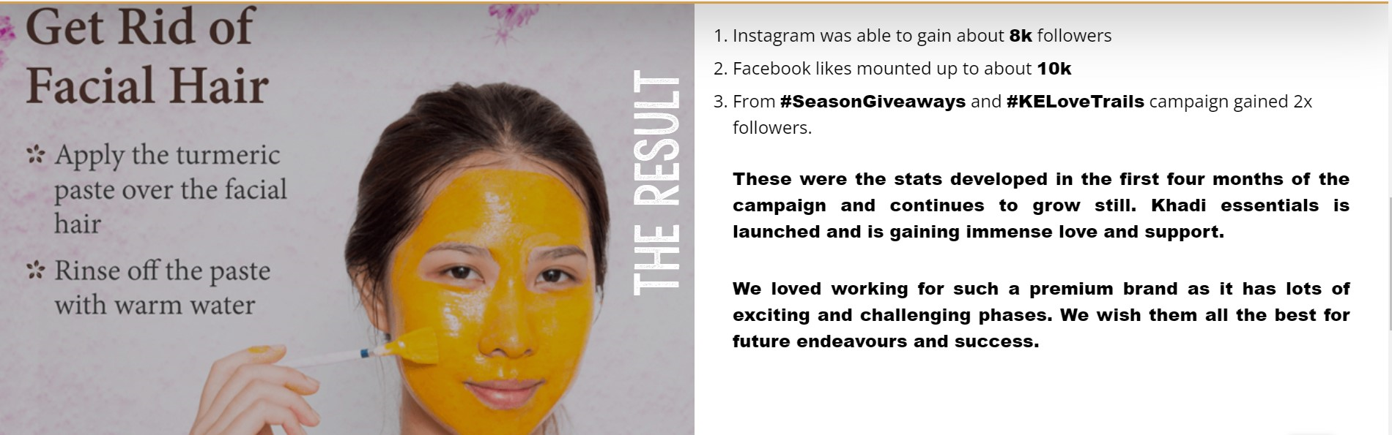
Part 4: Content Creation and Curation
Social Media Ad Campaigns

Slide 21
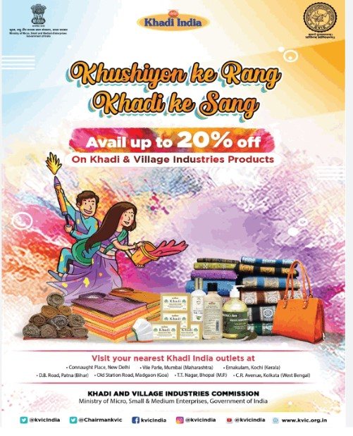
Part 4: Content Creation and Curation
Email Ad Campaigns

Slide 22
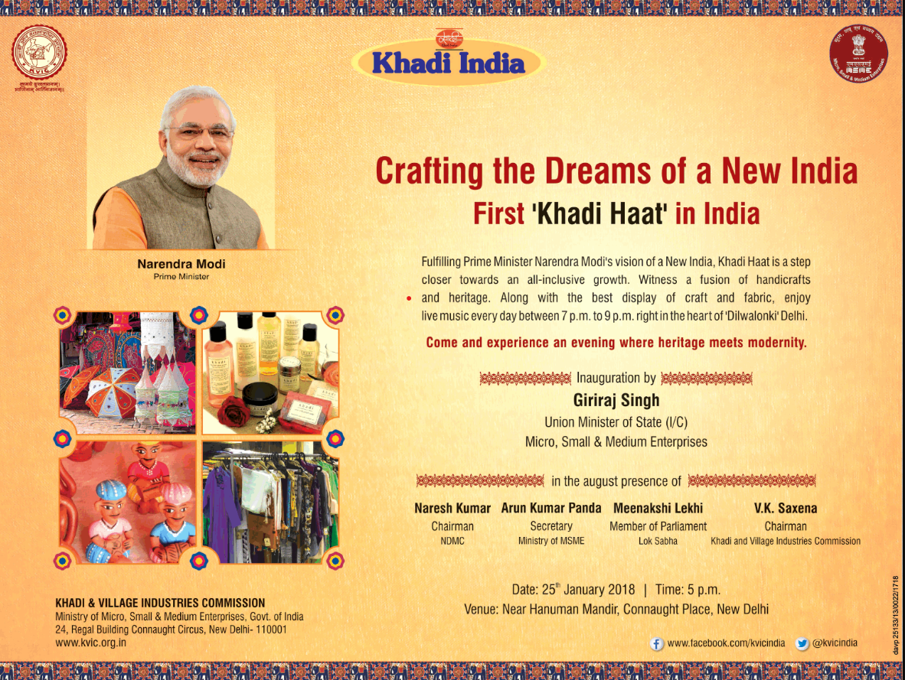
Email Ad Campaign 1 - Brand Awareness

Slide 23
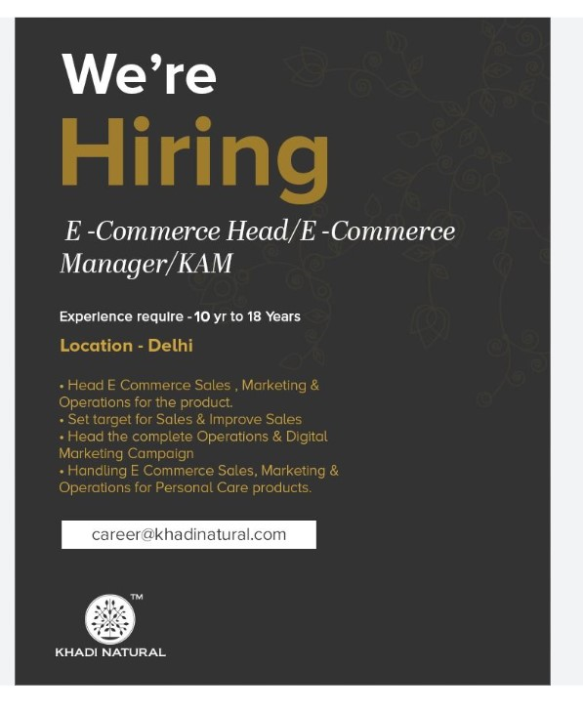
Email Ad Campaign 2 - Lead Generation

Slide 24
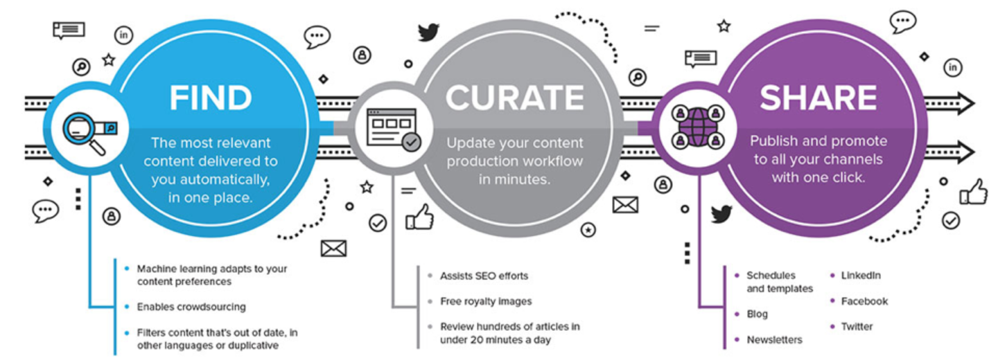
Part 4: Content Creation and Curation

Slide 25
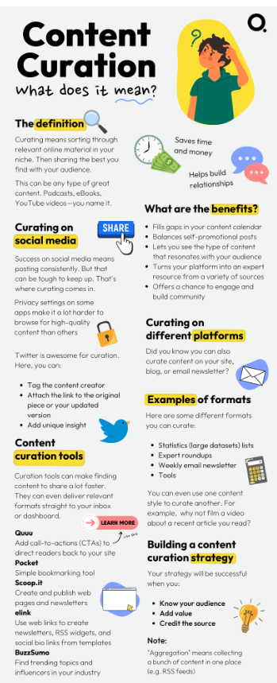
Part 4: Content Creation and Curation
Content curation is the act of finding and sharing excellent, relevant content to your online followers.
With content curation, companies deliver a wide variety of content to their customers, keeping them engaged with well-organized and meaningful material.
In today’s fast-paced and competitive marketplace, content curation is growing increasingly popular as a way of keeping up with growing demands for information and entertainment from customers.
Content curation is often a component of a content marketing strategy, but the two concepts aren’t the same. Content creation involves designing and promoting your material from scratch. The pieces you produce may be videos, blogs, podcasts or something else entirely.
Content curation entails searching for relevant content from other sources and brands rather than developing your own original content.

Slide 26
THE END

